Slide 1
CIS 4930/6930: Practical Cyber Security
Instructor: Xinming (Simon) Ou
TA: Xiaolong (Daniel) Wang

Slide 2
What is this Course About?
Goals of this course:
Learn basic cybersecurity knowledge (on both offense and defense side) through hands-on exercises
Understand how to reason about real-world security problems
Deepen theoretical concepts through practice
Become innovative in security technologies

Slide 3
Why Hands-on?
Because it is fun.
Because it keeps us honest – we cannot pretend we have learned (taught) it well.
But, more importantly…

Slide 4


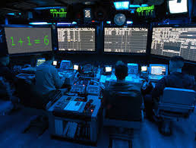
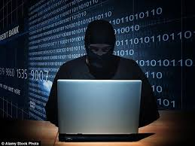
Cyber Security is a Human Problem
Defender
Attacker

Slide 5
To Improve Cyber Security
We need to build better systems
So that it is easier to secure by human
We need to improve the weaponry for defense
Good tools used by capable human defenders can thwart the threat

Slide 6


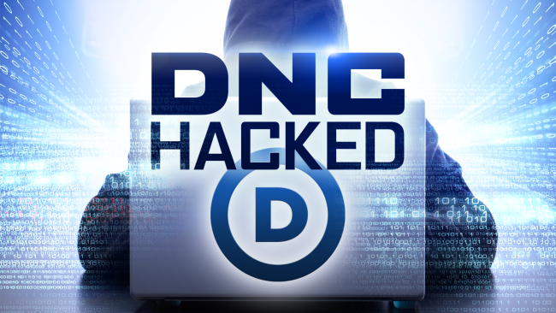



Why are we in such a state?

Slide 7
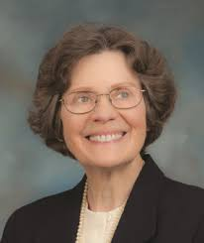
The Lost Battle
The hope of building an “inherently secure” system based on formal models.
“…most commercial systems would never be based on formal models. Technology was moving way too fast. Customers wanted the latest systems.
…
Systems with security flaws were going out the door, and customers gobbled them up.
…
Buyers were not about to wait for something that would be expensive, overly constrained, and obsolete even before it was delivered.
The Limits of Formal Security Models
Dorothy E. Denning
National Computer Systems Security Award Acceptance Speech, 1999.

Slide 8
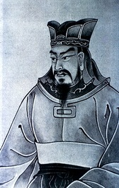
Two Overlooked Aspects
How attackers break things
知彼知己，百戰不殆；不知彼而知己，一勝一負；不知彼，不知己，每戰必殆
孫子兵法
If you know your enemies and know yourself, you will not be imperiled in a hundred battles; if you do not know your enemies but do know yourself, you will win one and lose one; if you do not know your enemies nor yourself, you will be imperiled in every single battle.
The Art of War, Sun-tzu

Slide 9
Related topics to cover in this course
Network scanning and reconnaissance
Network traffic sniffing and manipulation
Denial of Service attacks
Exploiting software vulnerabilities
Password cracking
Wifi cracking

Slide 10
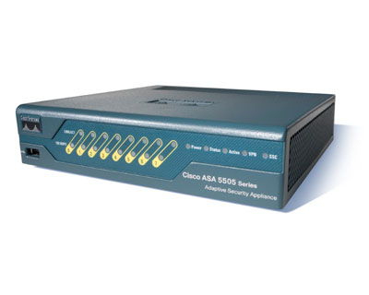




Two Overlooked Aspects
How humans use tools in defense

Slide 11
Can we have technologies to “take care of security?”
This is what it looks like…
Defender
Attacker

Slide 12

This is what it really is…
Users and data assets
IDS alerts
Defender
Network configuration,
Server logs, etc.
Host scan
reports
Shellshock
vulnerability!
Security advisories
Notes:
Defending a network system is highly labor intensive. Often times the defender has to look at multiple places and connect the dots to understand a problem and mitigate it.
My research has been focused on how to design automation techniques to assist the defenders. The key challenge is the reasoning system that can perform some of the tasks
that currently a human has to do.

Slide 13
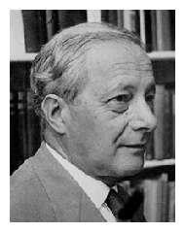
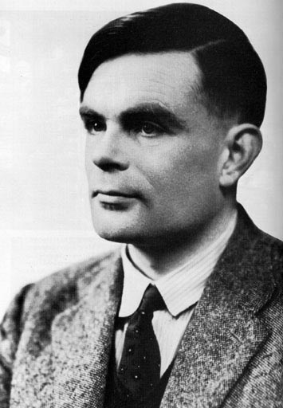
Tacit Knowledge and Automation
Michael Polanyi (1891-1976)
Alan Turing (1912-1954)
“We can know more than we can tell.”
Michael Polanyi. The Tacit Dimension. 1966.
Notes:
http://www.academia.edu/2557028/Michael_Polanyi_Can_the_Mind_be_Represented_by_a_Machine_Documents_of_the_Discussion_in_1949_in_Polanyiana_Budapest_19_2010_actually_2012_35-60
It is also worth noting that Polanyi’s formulation of tacit knowledge was partly spurred from a discussion in a 1949 symposium organized by the Department of Philosophy at the University of Manchester, on "Mind and Machine.” Both Michael Polanyi and Alan Turing were among the attendants of the Symposium and they had some very interesting debate on whether a machine can “think” like a human. In some sense our research is trying to design algorithms that will “think’ like a security analyst. It is an interesting observation that while Polanyi rejected the idea that human’s mind can be mechanized, his notion of tacit knowledge will play an important role in our research of trying to mechanize part of security analyst’s thought process.

Slide 14
Implications for Cyber Defense
We have to learn it by doing it
We can only improve the tools if we know how human defenders work in the trenches

Slide 15
Relevant topics to cover in this course
Firewalls
Intrusion detection systems
Security Information and Event Management System (SIEM)
Incident response and analytics
Network forensics

Slide 16
Course Structure
Lectures and Labs
Attendance is mandatory
Laptop is required
Assignments
Will be given out periodically to help you practice
You will be given VPN access to the infrastructure
Projects
There will be one or more larger-scale assignments that help cultivate comprehensive skills

Slide 17
Grade Calculation
20% - Attendance and doing the class activities
60% - Assignments
20% - Projects
Grading schemes for letter grades will be determined at the end of the semester

Slide 18
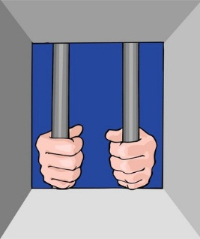
Why We Should Not Be Attackers
It is illegal:
United States Code, Title 18, Section 1030 (and others)
USA Patriot Act, Homeland Security Act, PROTECT Act
www.cybercrime.gov
Computer and Information Ethics
In other words:
Unauthorized access or use of a computer or network system is illegal
Unintentional attacks are also illegal

Slide 19
Penetration Testing
In the course we are NOT attackers
We are allowed to perform security/penetration testing only in the lab:
The owner of the machines authorizes security testing by members of the class on the lab machines
The systems being tested do not contain sensitive data

Slide 20
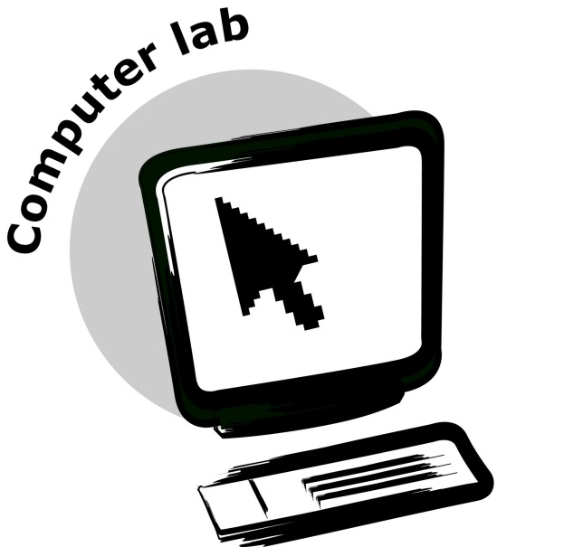
Lab Setup

Slide 21
Network Setup
IP: 10.247.49.*

Slide 22
Physical topology

Slide 23

Kali Linux
Kali is a Debain-derived Linux distribution that designed for digital forensics and penetration testing
Over 600 penetration-testing program
Easy to use
All tools are pre-installed
Free distribution: https://www.kali.org

